Slide 1
FRB Update
William Huang
(7/22/2020)

Slide 2
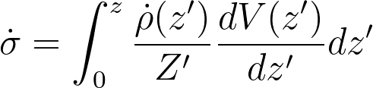
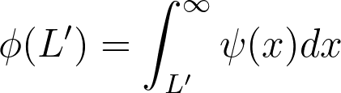
Steps to Finding the Luminosity Function
From your paper “Cosmological Evolution of Long Gamma-ray Bursts and Star Formation Rate”, I studied the steps to finding the luminosity function of, in the paper’s case, GRBs, but in our case FRBs.
Find where kendall tau = 0, create L’ vs. z graph (DONE)
Calculate \dot{\sigma}(z) and \phi(L’) using the data?

Slide 3
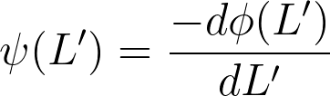
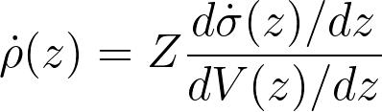
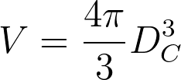
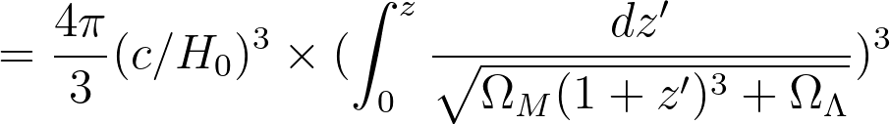
3. \psi(L’) and \dot{\rho}(z) can be calculated by first fitting smooth functions of step 2, then taking the derivative. This finds the density evolution.
4. The luminosity function, \Psi(L,z), can be calculated from the functions in step 3.
(using \Omega_k = 0)

Slide 4
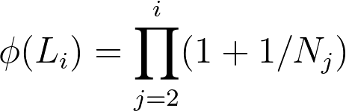
My question is about step 2:
How do you calculate these the functions in step 2 from the L’-z data?
I noticed the following formula in the paper for calculating \phi(L’). Could you explain why \phi is the product of 1 + the reciprocal of the number of objects in each associated set? Additionally, how would you calculate \dot{\sigma}(z)?

Slide 5
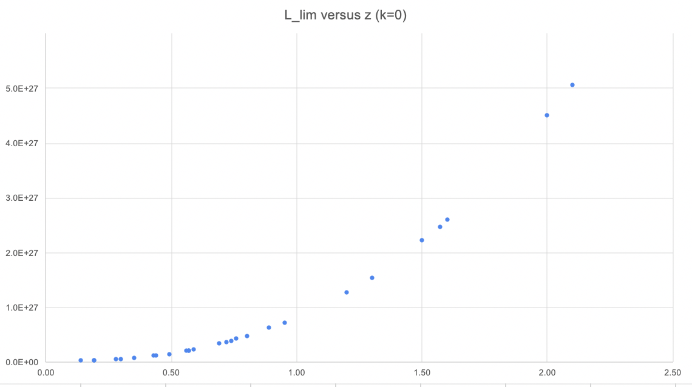
Sharp L_lim Problem
When plotting the original data for Parkes only, I found that L_lim actually had a very strong correlation with z, which when transformed by g(z,k) using k = 7.6 makes the resulting L_lim’ very close together. I am not sure what to make of this.

